Slide 1
Bread Sorter
Team Bread - Sorting Algorithm Visualizer
s1282003 Angelita Gozaly, s1282004 Zeke Sy, s1307017 Tuyet-My Pham

Slide 2
🍞 Introduction 🍞

Slide 3
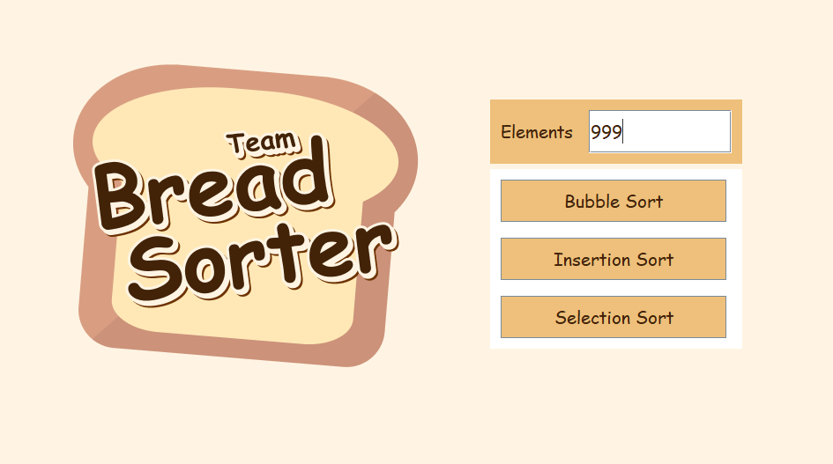
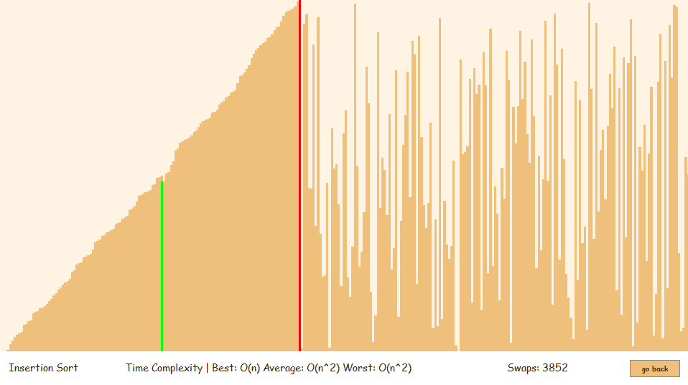
Bread Sorter
Selection Screen
Visualizer Screen
Notes:
Visualizer divided into two screens
Selection
Visualizer

Slide 4
🍞 Design 🍞

Slide 5
Goals
Approachable
Educational
Notes:
both approachable and educational.
easy for the user to use and understand
educational tool to understand the sorting algorithms better

Slide 6
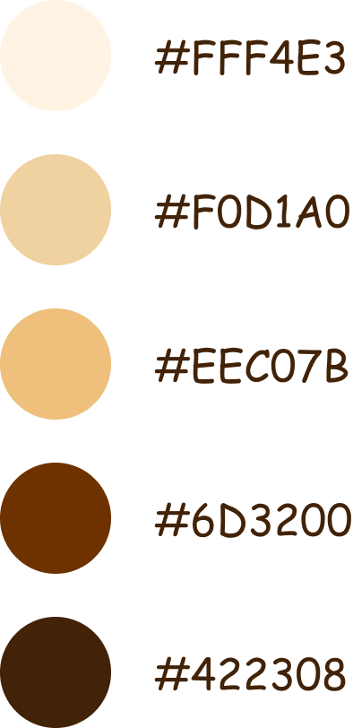
Theme
Comic Sans MS
Notes:
Based on - bread theme, we are team bread
Cute, light theme
Main colors: light beiges, supporting darker colors for typography
Chose Comic Sans MS for typography
Invoke feeling approachability
Homage to own memories
Teachers using handouts less daunting

Slide 7
🍞 Selection Screen
Element Number
Algorithm Buttons
Notes:
Simple text field assign numbers of elements
Buttons to select algorithms
All changeable and selectable items use same color
Suggest user to use both of them
Within scope of the project more sense implement buttons for selection
All options always available visible to user
“Suitability of task” principle minimise actions taken by user to reach goal
Only one button to activate

Slide 8
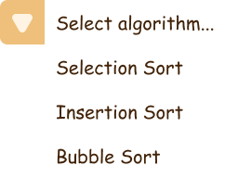
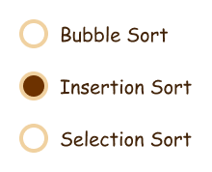
Problems of Buttons
Solution
Dropdown Menu
Not as easy to add algorithms
Change to different selection menu
Radio Buttons
Notes:
May cause problems adding more algorithms
Change to different selection
Easiest dropdown:
Options hidden away
Unlimited options can be added
Less user friendly bc problems with Hick’s law
Too many options to scan comfortably
Educational program so user doesn’t know options
Radio Button:
Leave options visible but also cause long list
Introduce clutter on selection screen

Slide 9
🍞 Visualizer Screen
Visualizer
Name of Algorithm
Time Complexity
Swap Counter
Back Button
Notes:
Visualizer
Small label for algorithm name
Time complexity, for education
Swap counter goes up while runs
Back button
Give user choice to go back and select another setting or when they accidentally select the wrong algorithm.
Reduce clutter by separating selection and visualizer.

Slide 10
🍞 Timeline 🍞

Slide 11
🍞 Timeline
DEC
DEC
JAN
JAN
Initial planning
Problem with Visualizer
Inflexible structure and code
Unorganized code
Notes:
So now I will be talking about our timeline. It definitely wasn’t easy at all and just like a lot of other coding projects a lot of changes had to be made during development. I will explain the problems we faced, and how we changed our system to solve them.

Slide 12
🍞 Timeline
DEC
DEC
JAN
JAN
Initial planning
Problem with Visualizer
Inflexible structure and code
Unorganized code
Notes:
Firstly this was our initial plan. We essentially were going to have only 1 Frame that had the buttons e.g choosing the sort, setting size of array etc at the top then the visualizer sort below it.

Slide 13
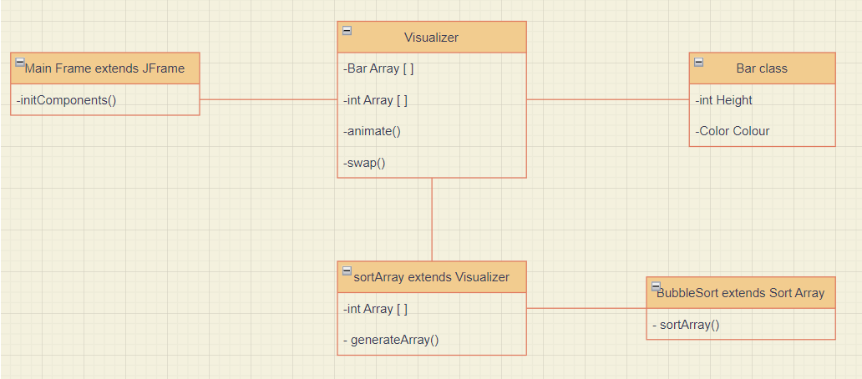
Initial planning
Notes:
In terms of the architecture's design, essentially we planned to separate the GUI into the mainFrame class and use the Visualizer class to bridge the gap between the algorithms and the GUI. The Visualizers main job would be doing the animation. To do that we initially were thinking of creating a bar class, and then have a special swap function that would swap the int array values that were swapped during the sort and then also swap the bar heights in the bar class and paint them again onto the frame. However, we ran into some problems which I will explain and had to change the design.

Slide 14
🍞 Timeline
DEC
DEC
JAN
JAN
Initial planning
Problem with Visualizer
Inflexible structure and code
Unorganized code
Notes:
So essentially we only found out the issue later on. To begin with our group did the GUI first then we were programming the bar class and then the different sorts. We essentially finished programming the back-end of the code and it worked fine. However, when we started to program the visualizer we ran into a few problems.

Slide 15
Problem with Visualizer
Java Swing Bar class
How drawing things with Java Swing worked
repaint() function
Notes:
To draw bars in Java Swing there was already an existing bar class array. This wasn’t necessarily a problem, it just made the bar class basically redundant. So we got rid of it entirely.
Another slight just lack of knowledge about the swing class is also not a problem but with how animation works it needed a JPanel and could not directly be done into the frame so we would have to split the main Frame and the Jpanel inside it to 2 different files because we didn’t think it made sense that the animate function be directly into the mainFrame which was supposed to be only for the GUI side. Hence we made the Visualizer class extend JPanel so that it could do the animate function(). Leading to the main problem.
We soon came to realise that using the repaint() function didn’t just repaint the changed components but the entire panel again. So it had the issue of redrawing the initial array again and again. Again ,with our lack of experience with the Java swing package at the time, our way we solved this was to just have the animate() draw the entire bar array and then just make individual swaps inside the visualizer array instead. Making our architecture look like this basically, making most of the functions in the other files sort of redundant.

Slide 16
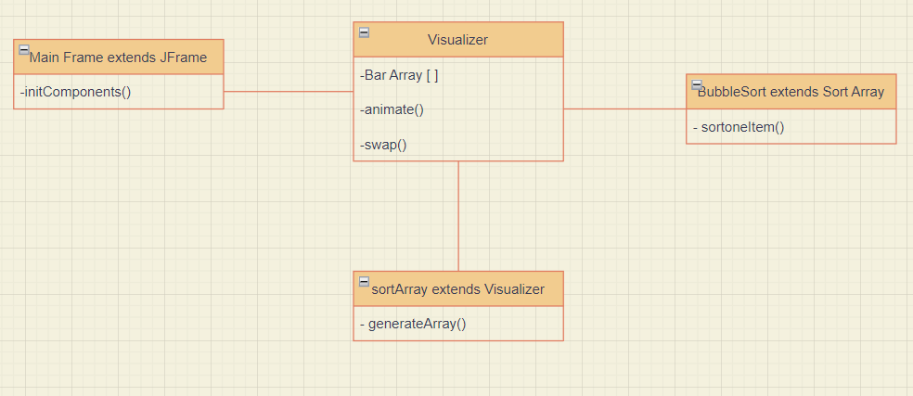
Notes:
Making our architecture look like this basically, making most of the functions in the other files sort of redundant.

Slide 17
🍞 Timeline
DEC
DEC
JAN
JAN
Initial planning
Problem with Visualizer
Inflexible structure and code
Unorganized code
Notes:
Of course this architecture isn’t very good and there are few issues.

Slide 18
Inflexible structure and code
Doesn’t utilize the advantages of OOP
Adding new sorts isn’t easy
Basically all the code can be put in one file
Notes:
This sort of structure doesn’t make use of OOP advantages, like inheritance, polymorphism etc and doesn’t make sense conceptually for an Object oriented program.
Adding sorts isn’t very easy, since the sorts are being called through if statements in the visualizer, adding more sorts will not only make visualizer much longer but the separated sorted files like bubble sort will only have one function of returning the index of what should be swapped.
This leads to the last problem, but basically one file can have all the code and again just showcases the issues of the structure.

Slide 19
🍞 Timeline
DEC
DEC
JAN
JAN
Initial planning
Problem with Visualizer
Inflexible structure and code
Implemented Design
Notes:
So taking all of these things into account we now came up with our current structure that makes a lot more sense conceptually and in an OOP way of solving the task.

Slide 20
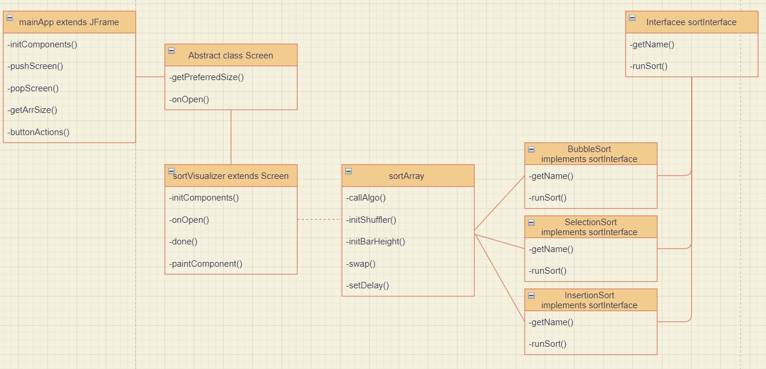
Implemented Design
Notes:
First we have our MainFrame which acts like the main menu and has functions that control the different panels that get displayed.
Next we have an abstract screen class, which extends JPanels. It defines the functions get preferredSize which will set the size of the panel that will pop up and also has onOpen() which defines the steps the panel will do when opened. More will be explained with the Sorting visualizer. We have this because initially we were going to split the mainFrame and what's on it onto a separate mainMenu Jpanel but decided that it wasn’t necessary. However ,doing it in this way means that we can add more screens quite easily in the future, for example maybe a help screen that will give instructions on how to use the application.
Now we move onto the Sorting visualizer which extends the screen class, meaning it is a type of panel. We can see later how it works in the demo. It basically opens, creates the bar height array and the bars, then shuffles the bars and sorts it. This is all done in an animation. It calls the other sorts to sort the array and just provides the visual part, it doesn’t actually do any of the sorting.
The controller where the sorting will be done is the sortArray. We added this too further just separate the GUI part and
The sorting will be done by the various sorts, and with this architecture it's much easier to add any new sorts. This is due to the fact that you can pretty much plug in any sort in its normal form with the code, but you just need to keep track of the two bars being checked and swapped for the animation.
Lastly, we have our sortInterface that all the sorting Algorithms implement. This allows us to achieve total abstraction with the various sorts and makes it easier to conduct multiple inheritance which will be needed since we have 3 different sorts. This also makes it easier in the future to be able to add any new sorts.
Now with this structure I believe utilises the advantages of OOP programming, i.e our sortInterface, ‘our screen class and the visualizer extending it etc. Making future additions to the application is quite straightforward and it makes a lot more sense conceptually.

Slide 21
System design Features
Effectively utilizes OOP advantages like inheritance, abstraction etc in the system
Uses a screen class so that it is easier to add new screens in the future for example a Help screen that explains the sorts and how the sorting visualizer works.
Has a sortInterface which every single sort will implement for abstraction and better readability
Seperated the GUI and algorithms, indicated by dotted line, easier to separate working on the GUI and the algorithms if there was a group of programmers
With the sortArray class, new sort algorithms are easy to add since the base code of a normal sorting algorithm is barely changed when added.

Slide 22
Features
Has Bubble Sort , Insertion Sort, Selection Sort
Visualizer shows the two bars being compared in a red and green colour so you can see the traversing of the array for the different sorts
User can input number of elements in the array
Time Complexity of different sorts appears at the bottom
Number of swaps counted as a metric to compare the different arrays speeds
Different delays during swaps for different number of elements in the array so user can properly see the swapping during the sort
More elements has a shorter delay so the animation is faster
Less elements has longer delay so animation is slower

Slide 23
Demonstration

